Slide 1
TEKNOLOGI DATA WEEK 5
Gunawan Budiprasetyo, ST, MMT, Ph.D

Slide 2
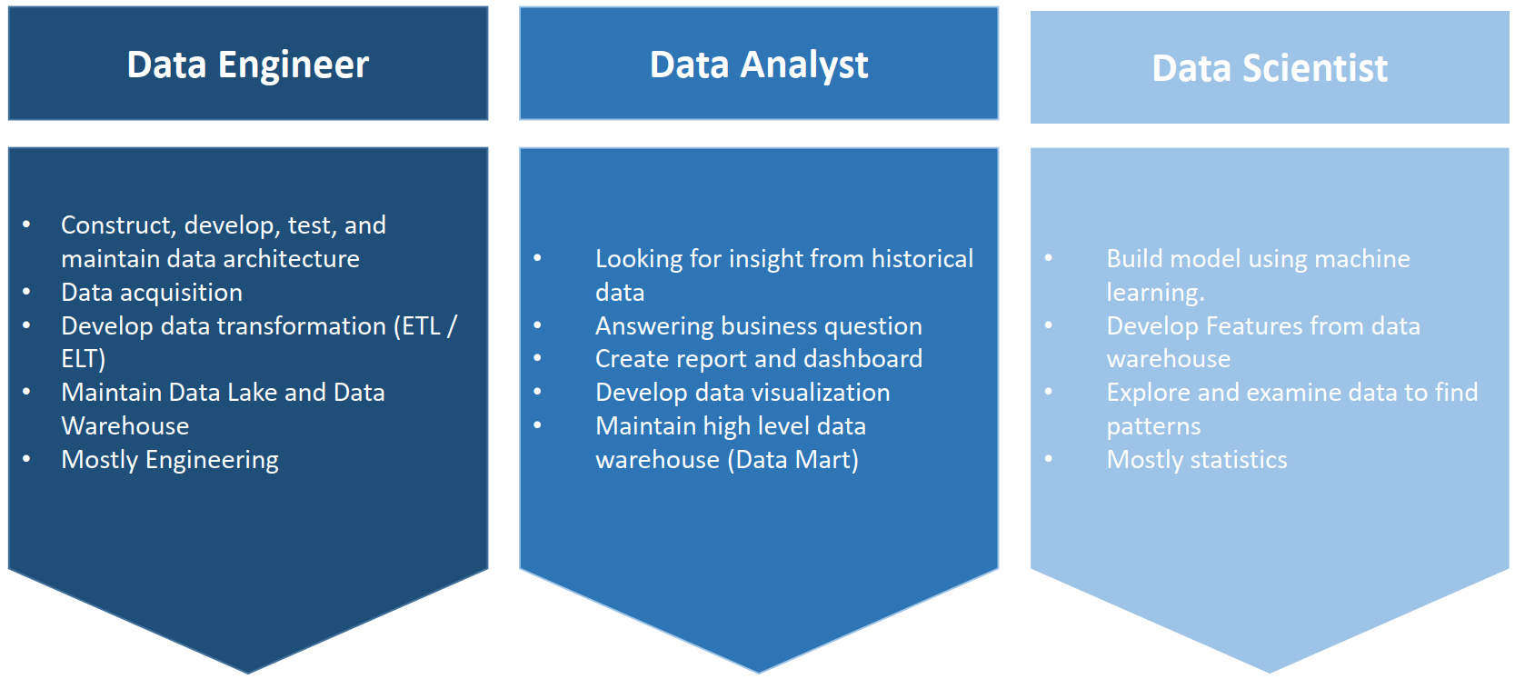
Data Profession

Slide 3
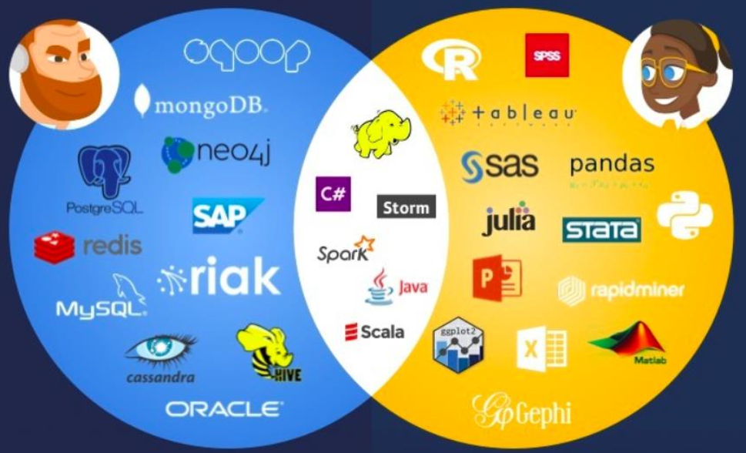
Languages, Tools and Softwares

Slide 4
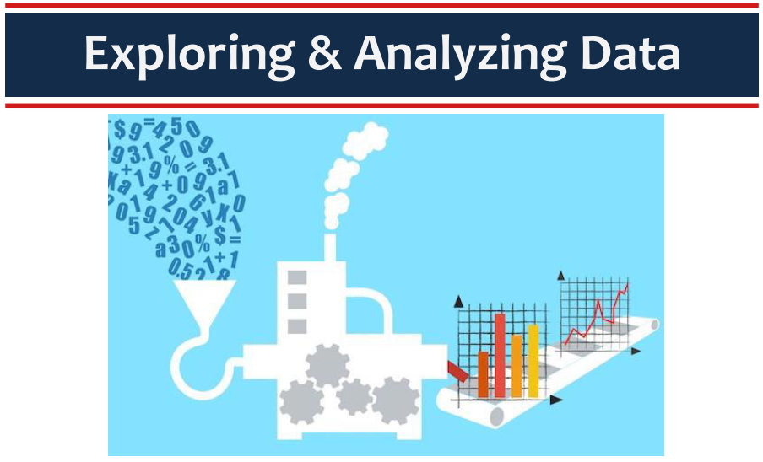

Slide 5
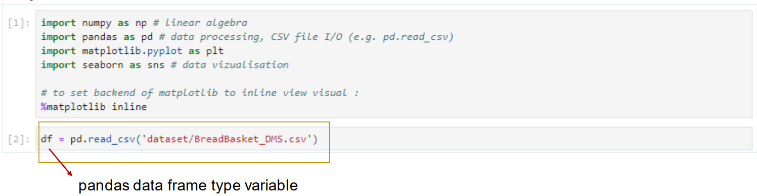
Import Dataset

Slide 6
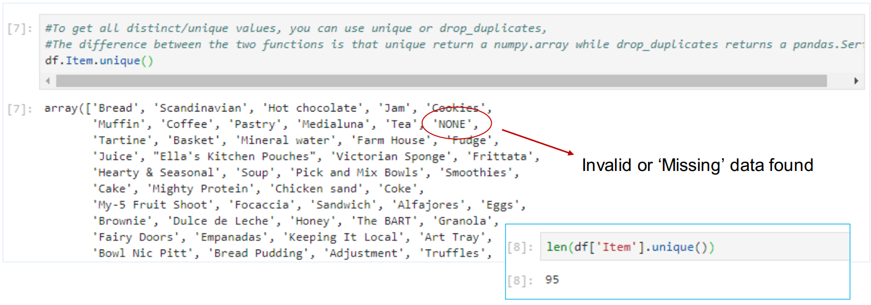
Get Distinct/Unique Value

Slide 7
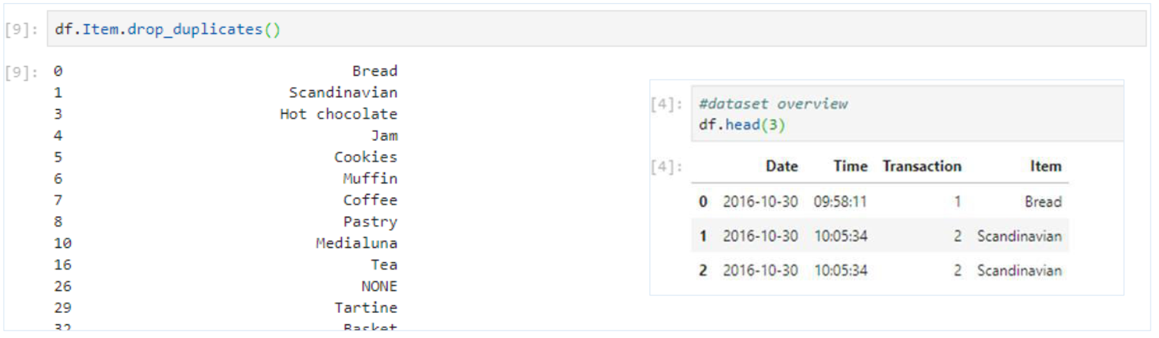
Displaying Unique Item by Removing Duplicates Data in a Column

Slide 8
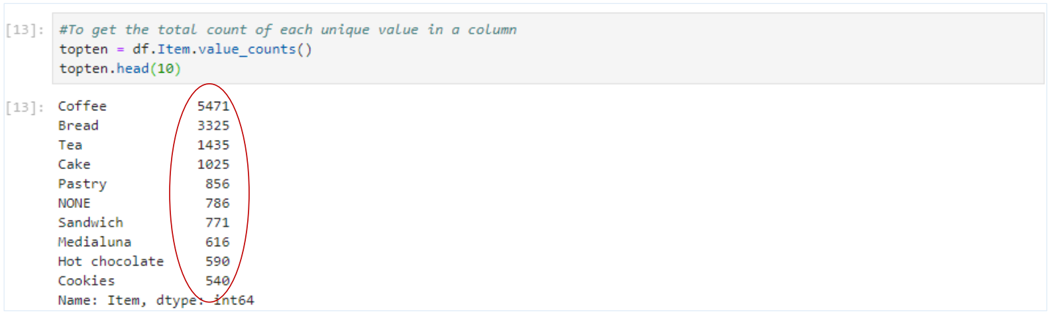
Display Unique Value and Its Total Count

Slide 9
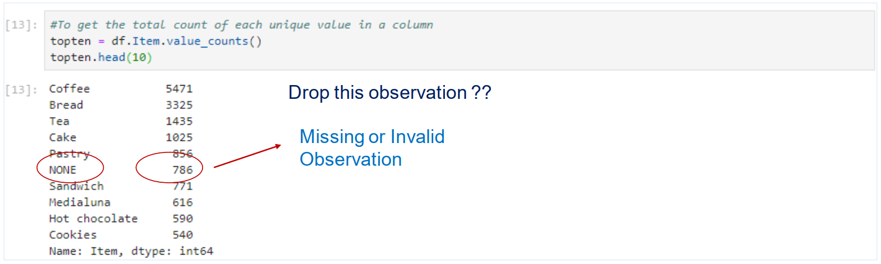
Missing Observation

Slide 10
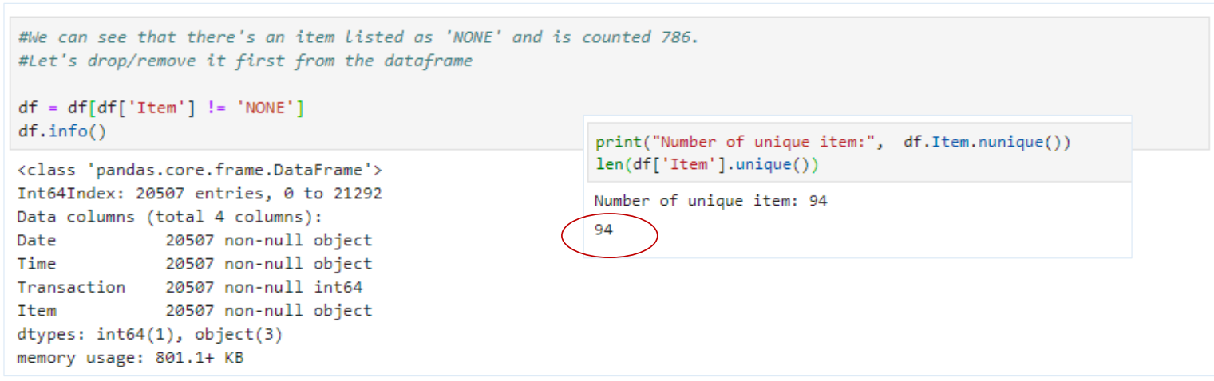
Drop/Remove Row from Data Frame

Slide 11
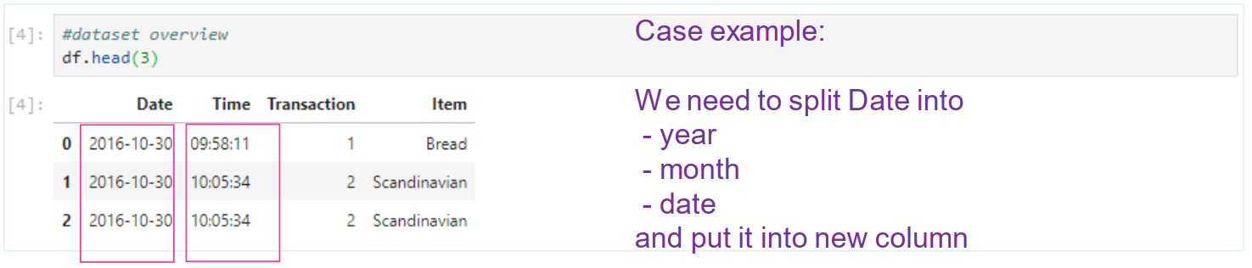
Split String in DataFrame

Slide 12
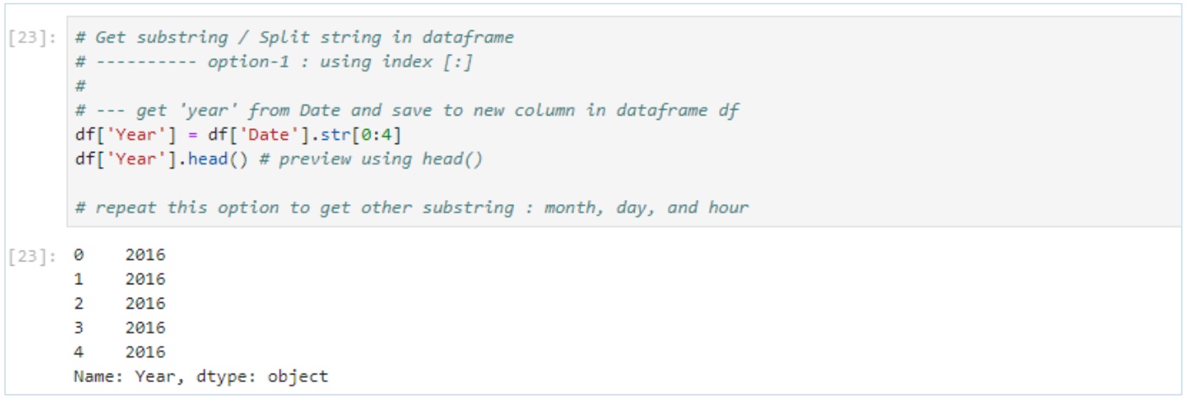
Split String and Add New Column to Data Frame

Slide 13
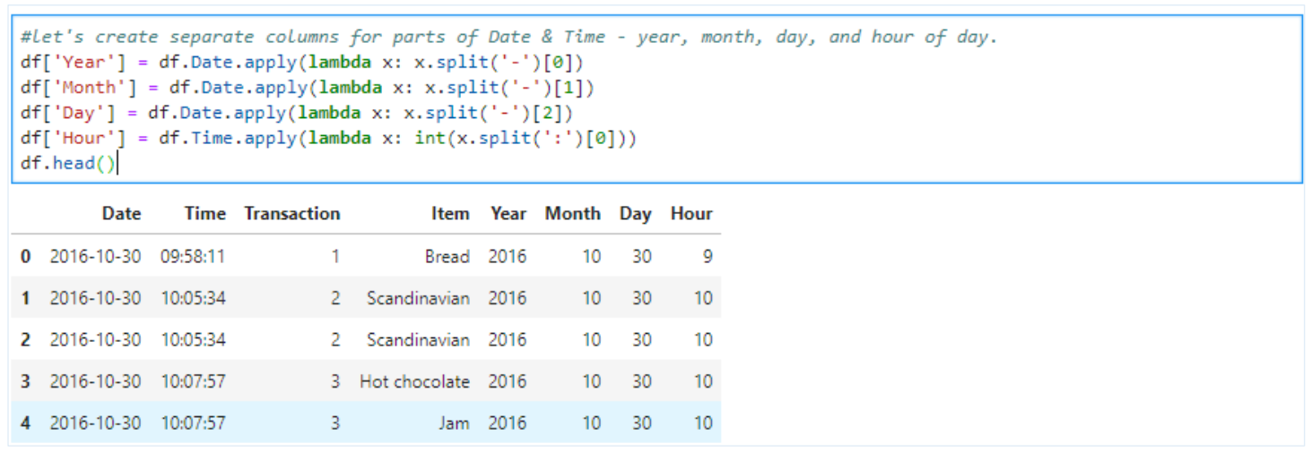
Split String and Add New Column to Data Frame

Slide 14
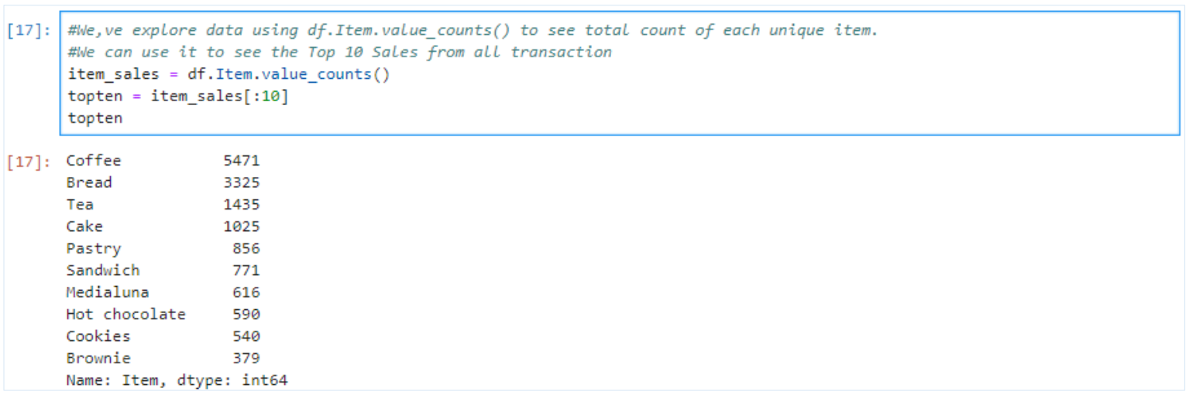
Review Top 10 Unique Items

Slide 15
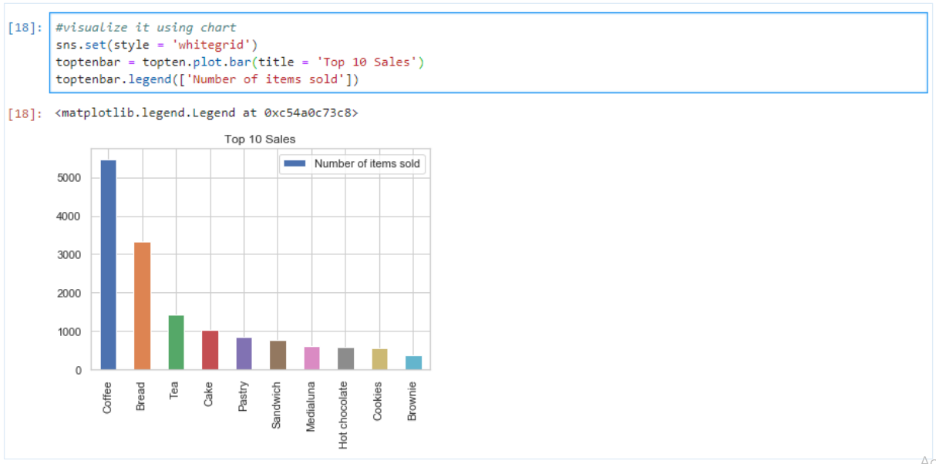
Visualizing Using Chart

Slide 16
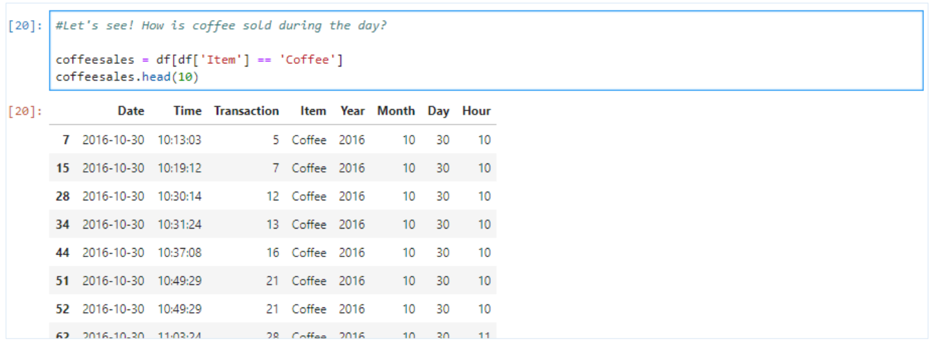
Let’s See Another Insight

Slide 17
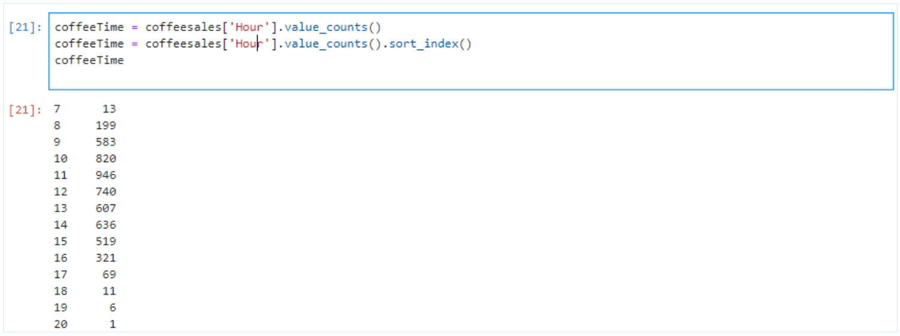
Other Cofee Transaction Information

Slide 18
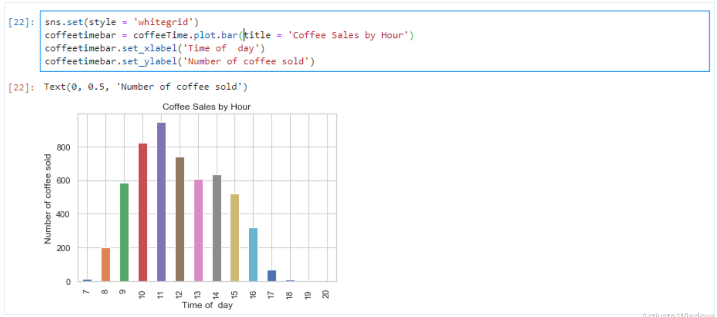
More Visualization

Slide 19
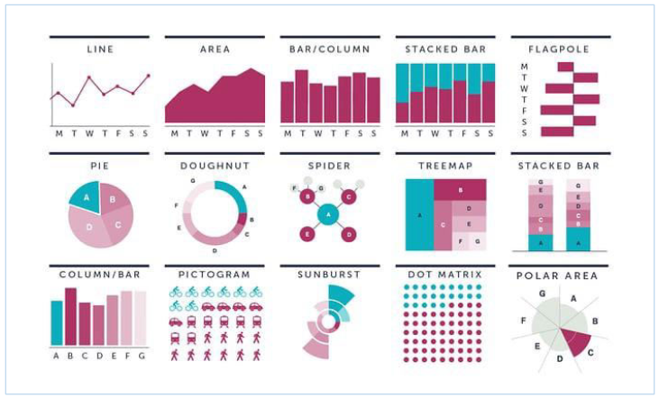
Data Visualization in Python

Slide 20
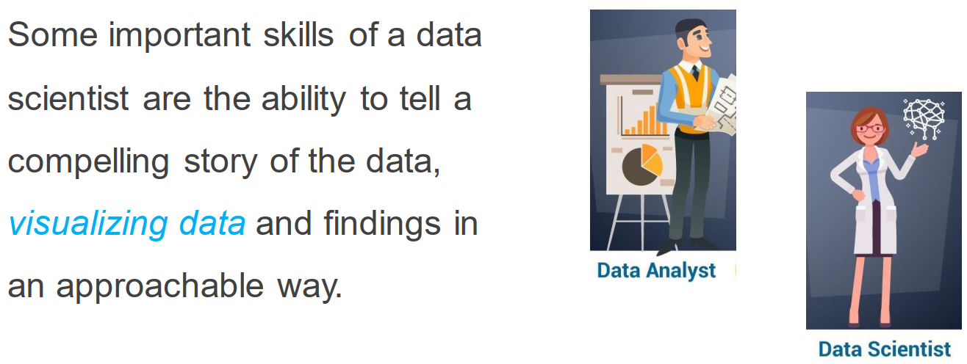
Data Visualization

Slide 21
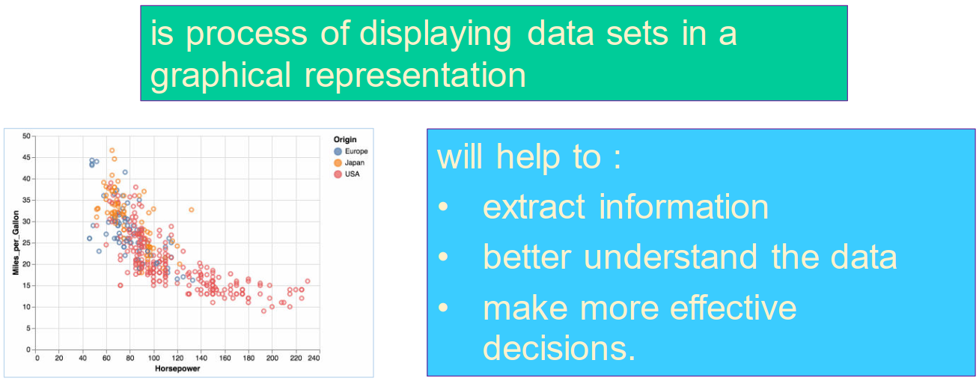
Data Visualization

Slide 22
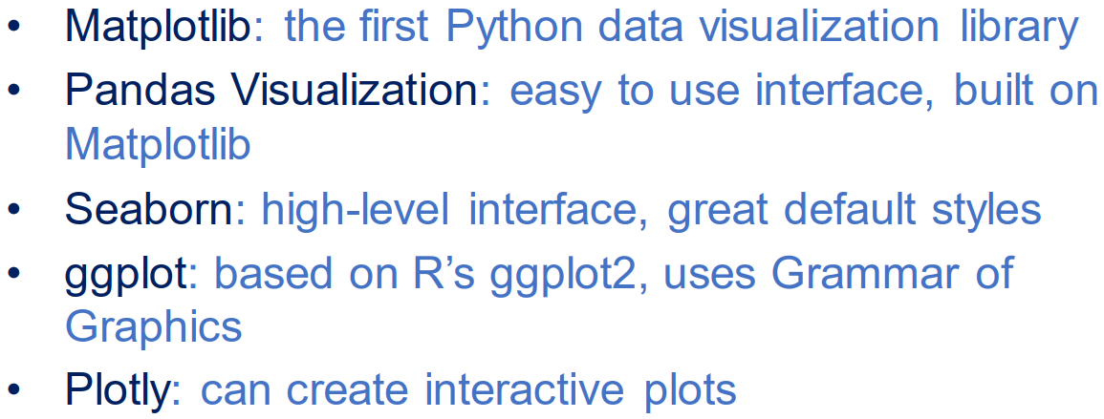
Popular Plotting Library

Slide 23
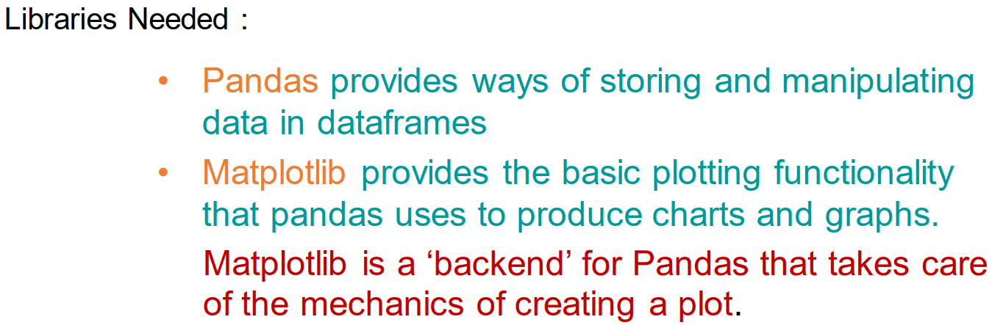
Plotting with Pandas and Matplotlib

Slide 24
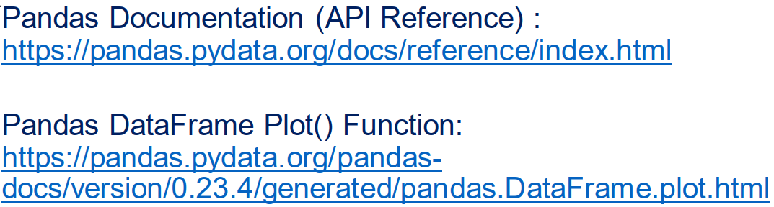
Python Pandas Library

Slide 25
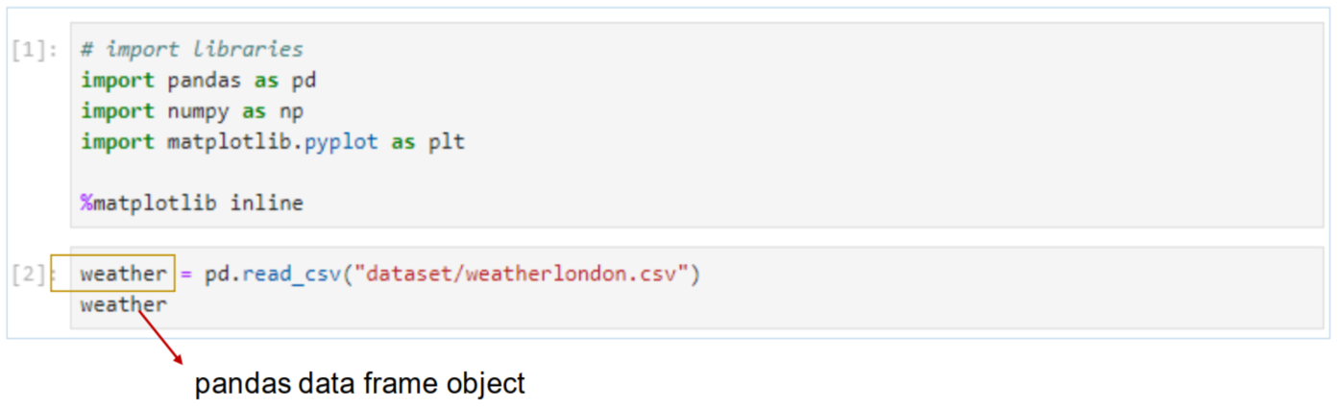
Import Libraries and Dataset

Slide 26
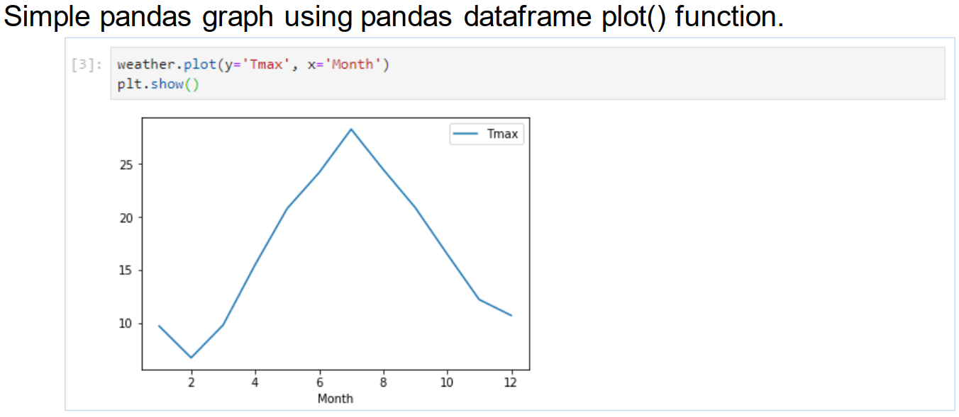
Simple Pandas Graph

Slide 27
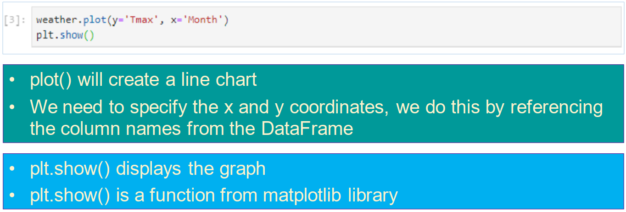
Pandas DataFrame plot() Function

Slide 28
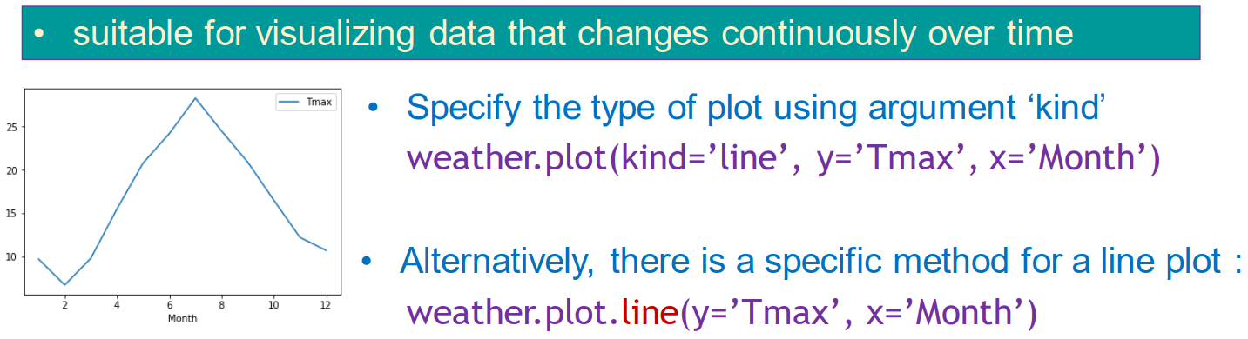
Line Chart

Slide 29
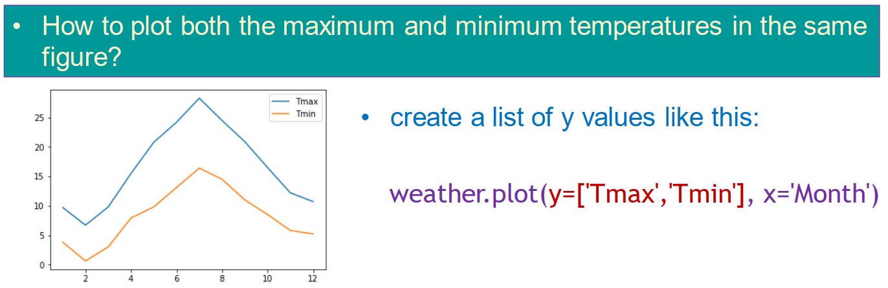
Multiple Line Plots

Slide 30
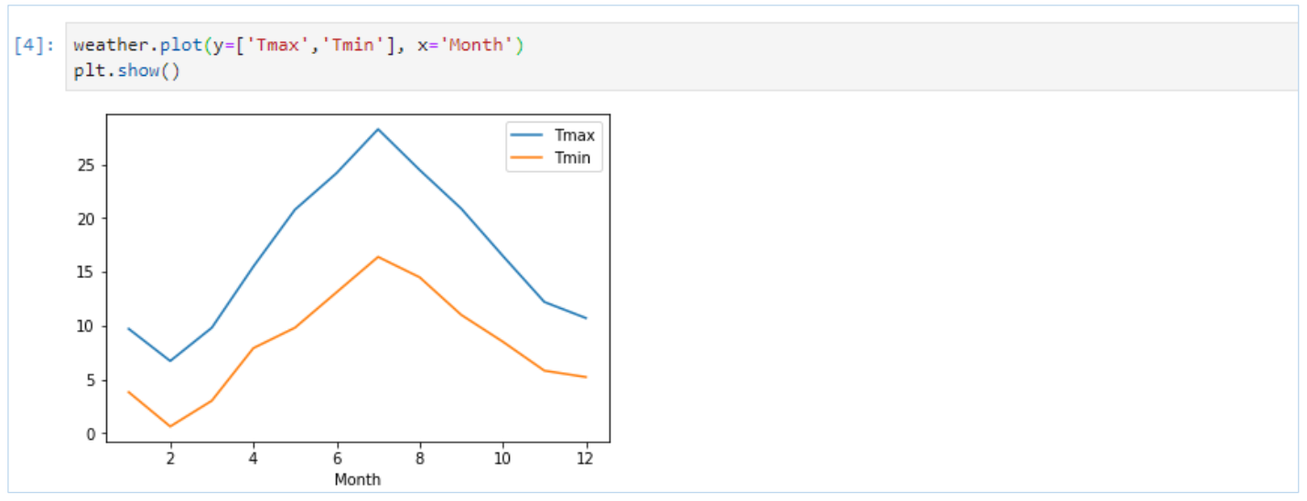
Multiple Line Chart

Slide 31
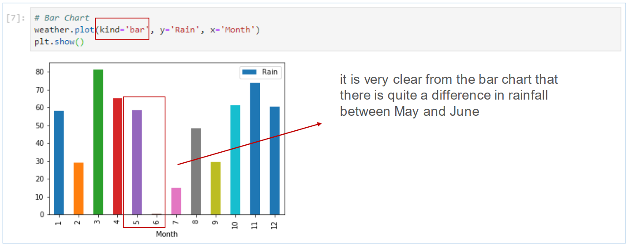
Bar Chart

Slide 32
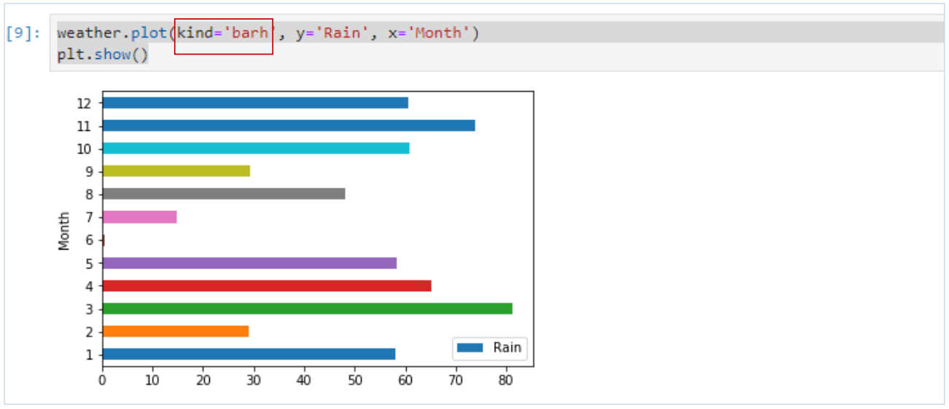
Horizontal Bar Chart

Slide 33
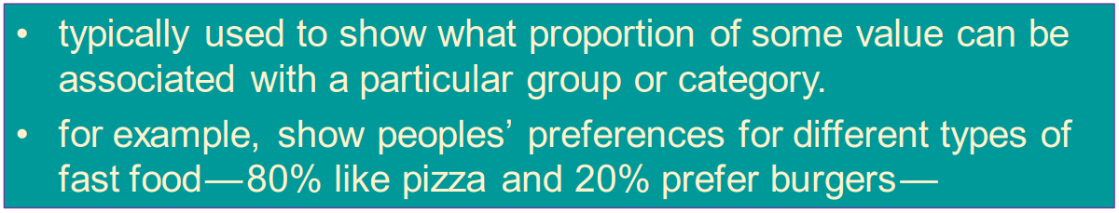
Pie Chart

Slide 34
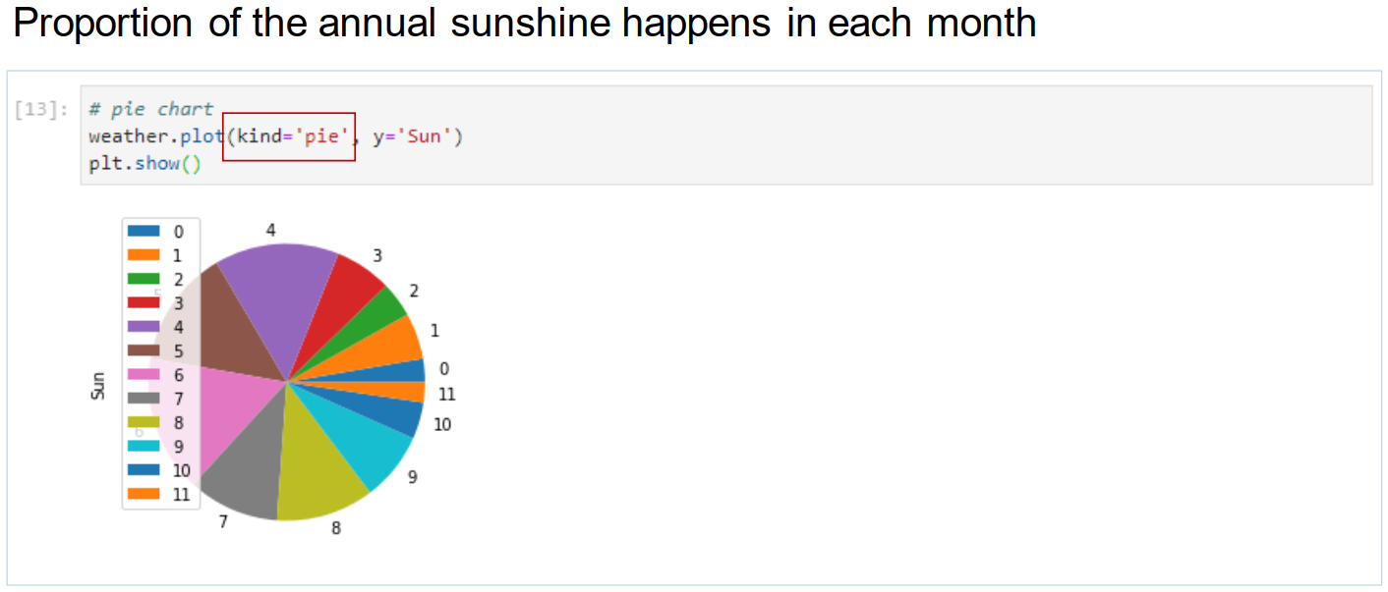
Pie Chart

Slide 35
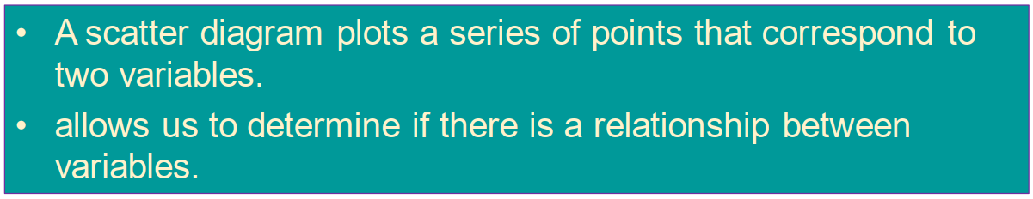
Scatter Diagram

Slide 36
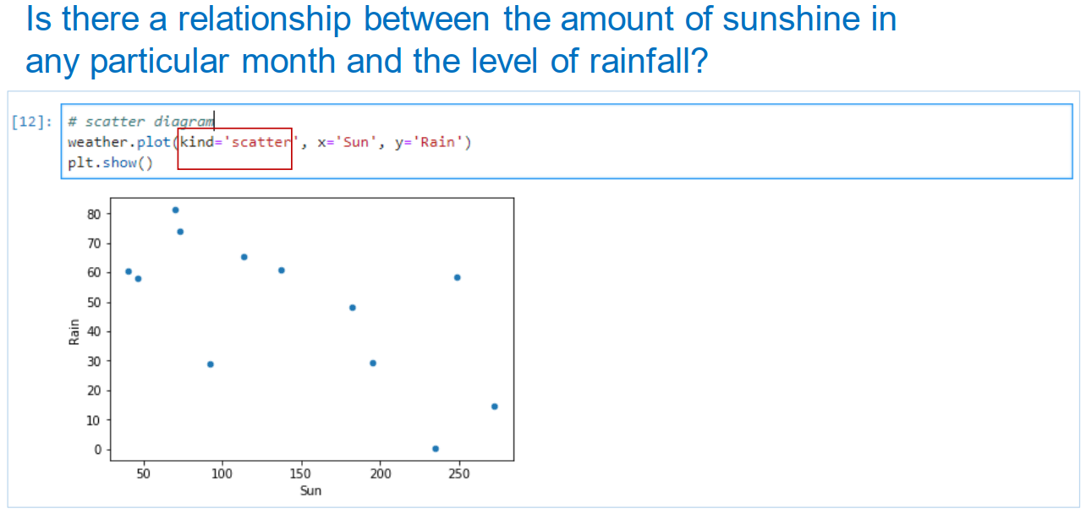
Scatterplot

Slide 37
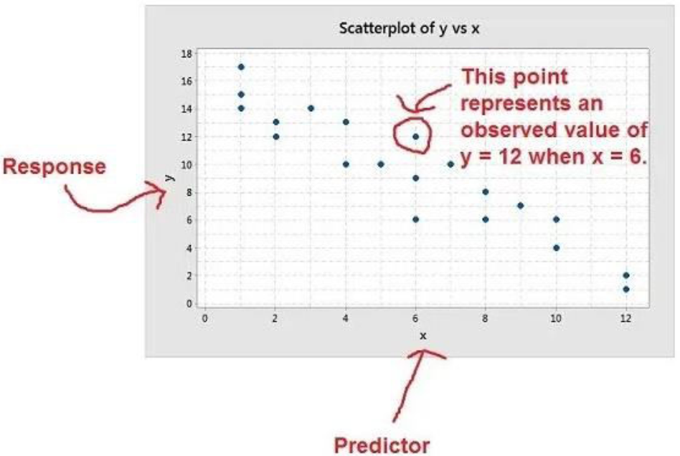
Basic Structure

Slide 38
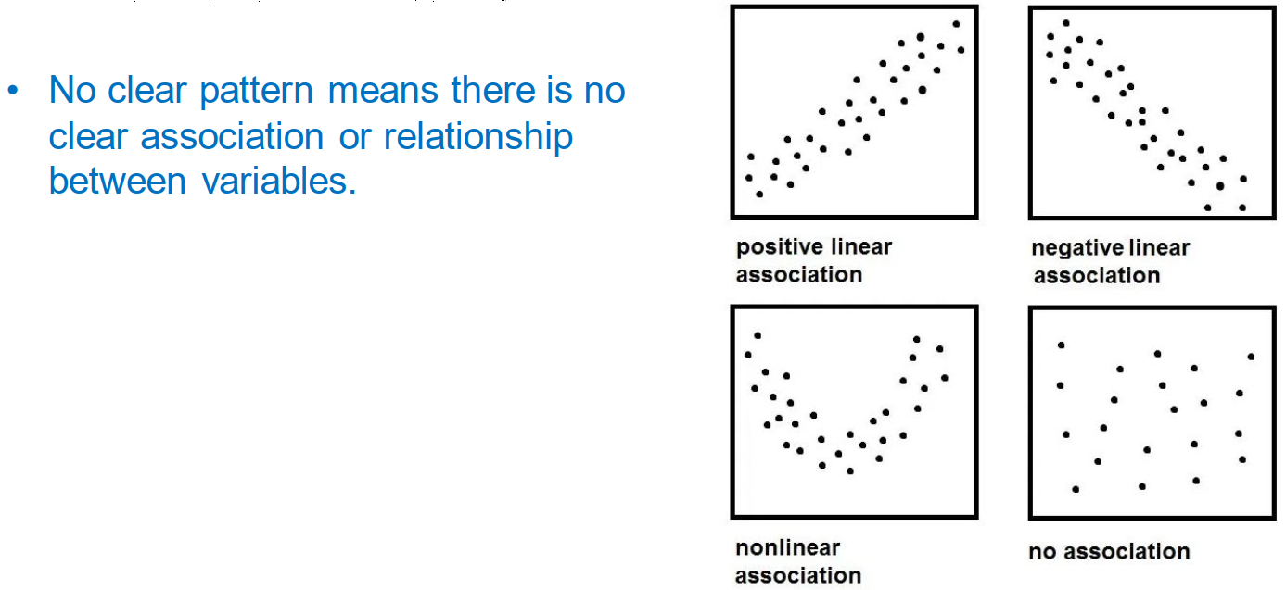
Interpret the Scatterplot

Slide 39
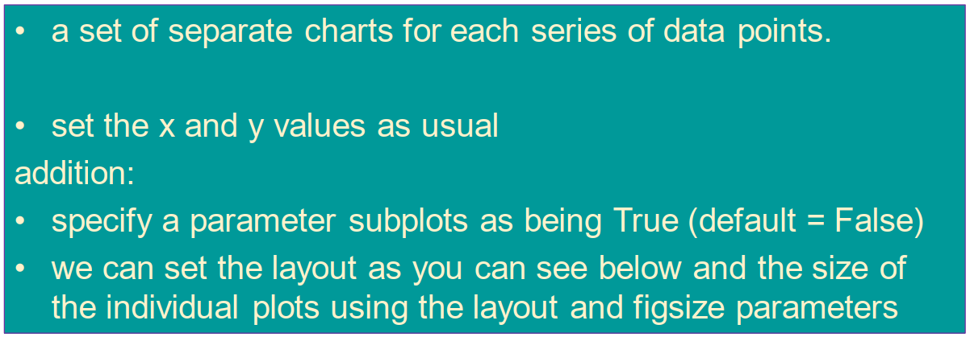
Multiple Chart in Pandas Plot Utilities

Slide 40
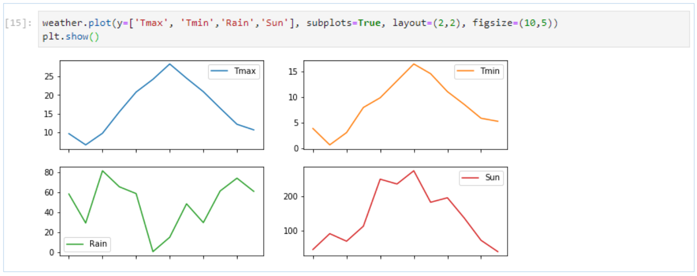
Multiple Chart

Slide 41
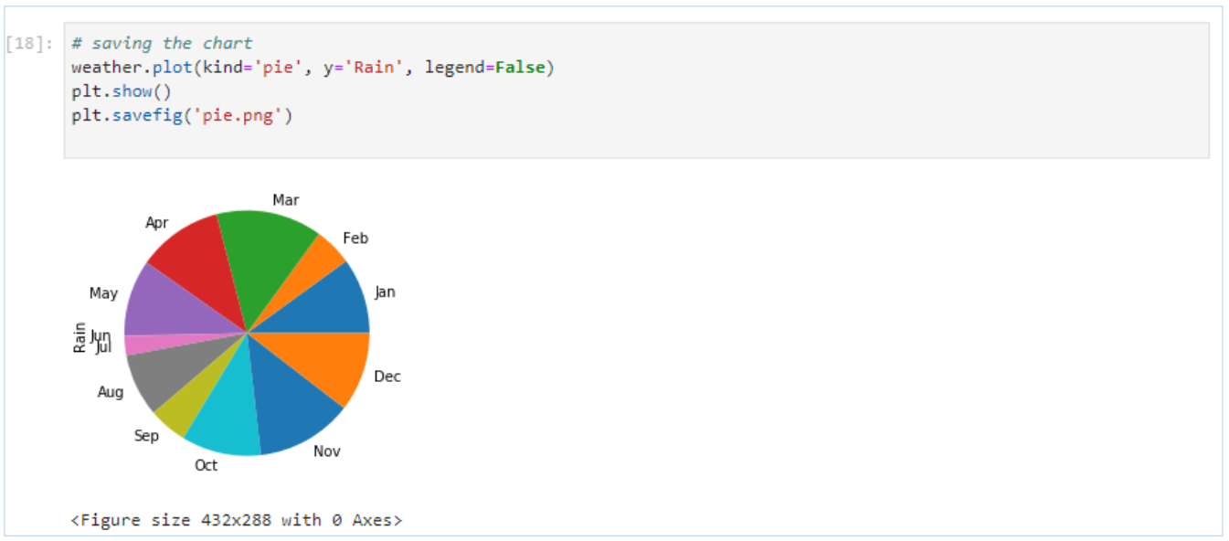
Simply Saving Chart

Slide 42
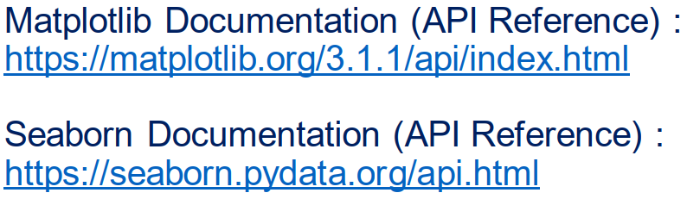
Matplotlib and Seaborn Documentation

